Slide 1
Welcome to
Our Sunday School
We’ll start at 9:07
visit OurSundaySchool.com for more about our class

Slide 2
Today’s class (pages 98-104)
Philippians 1:28b-30

Slide 3
Philippians 1:28b-30 (CSB)
This is a sign of destruction for them, but of your salvation—and this is from God. For it has been granted to you on Christ’s behalf not only to believe in him, but also to suffer for him, since you are engaged in the same struggle that you saw I had and now hear that I have.

Slide 4
Today’s class (pages 98-104)
Philippians 1:28b-30

Slide 5
Prayer Time
Write down your prayer requests (on the Weekly Update or in the comments)
Lean in, engage, and pray for someone not with you
Go worship

Slide 6
Today’s class (page 16)
Preparing for Philippians 1:1-30
Pray with others
Hear with others
Think with others
Study with others In class, as a table
Share with others
Invite others After class
In class, as a class

Slide 7
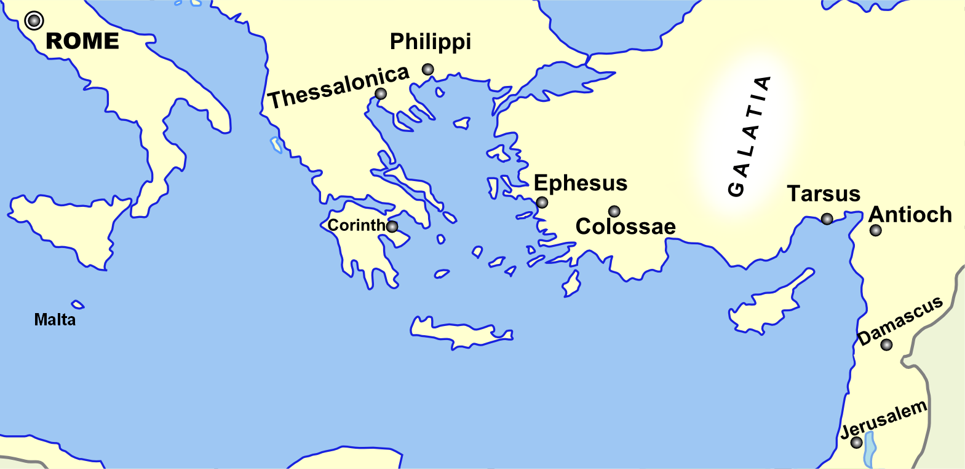
Monozigote. (2012). Broad Overview of Geography Relevant to Paul of Tarsus [Map]. Wikipedia.

Slide 8
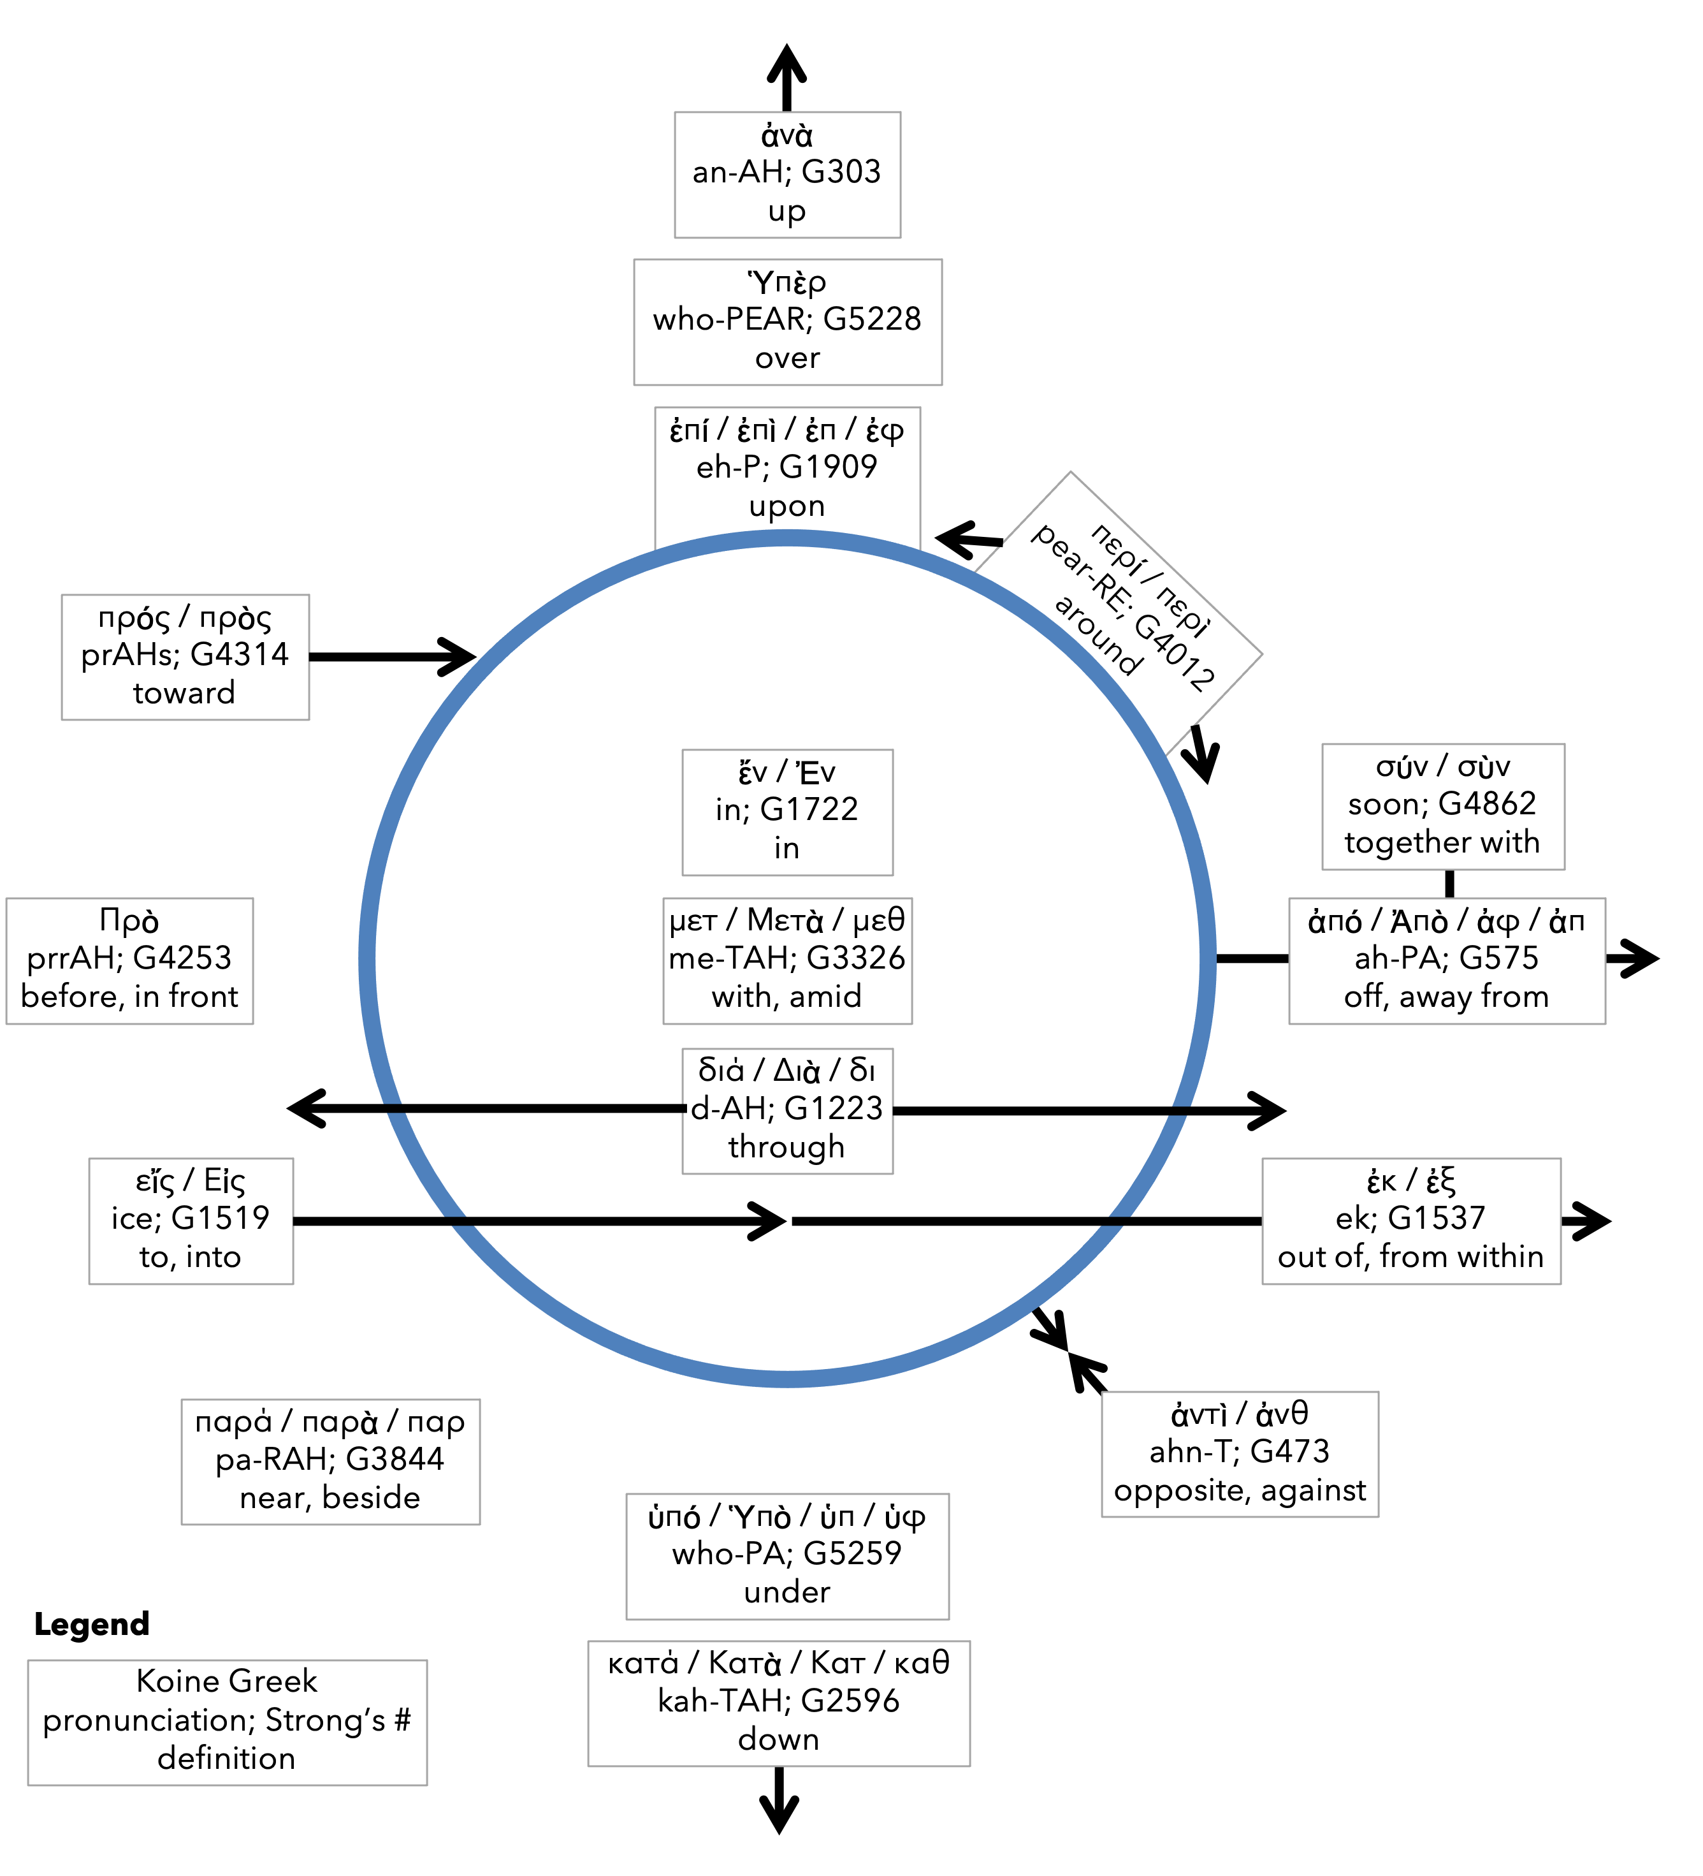
Preposition circle (page 11)

Slide 9
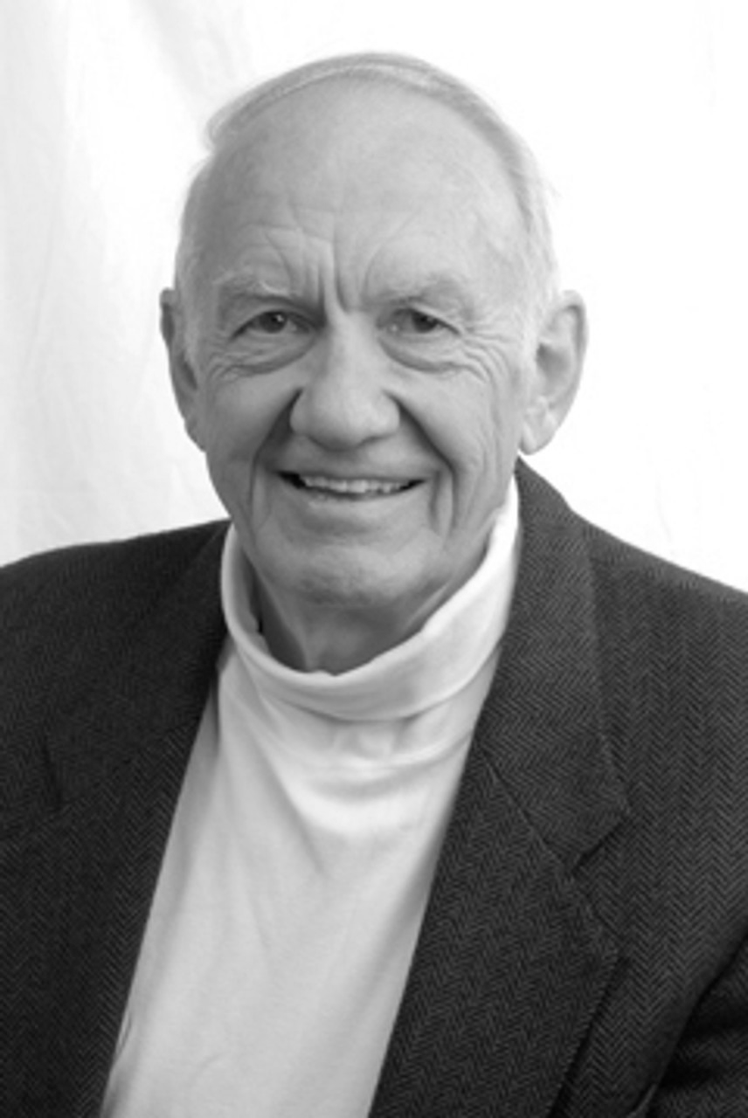
Dr. Gordon Fee Quote

Slide 10
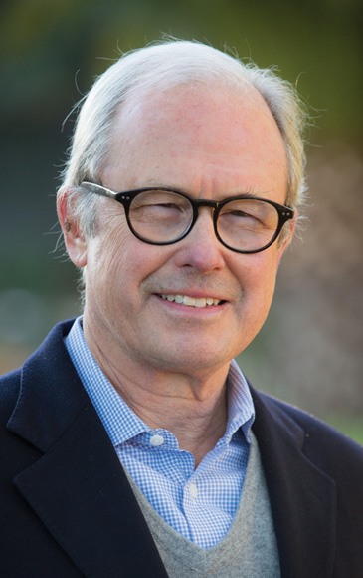
Dr. G. Walter Hansen Quote

Slide 11
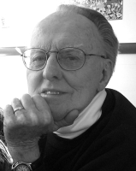
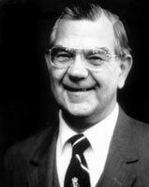
Dr. G. F. Hawthorne & Dr. Ralph P. Martin Quote

Slide 12
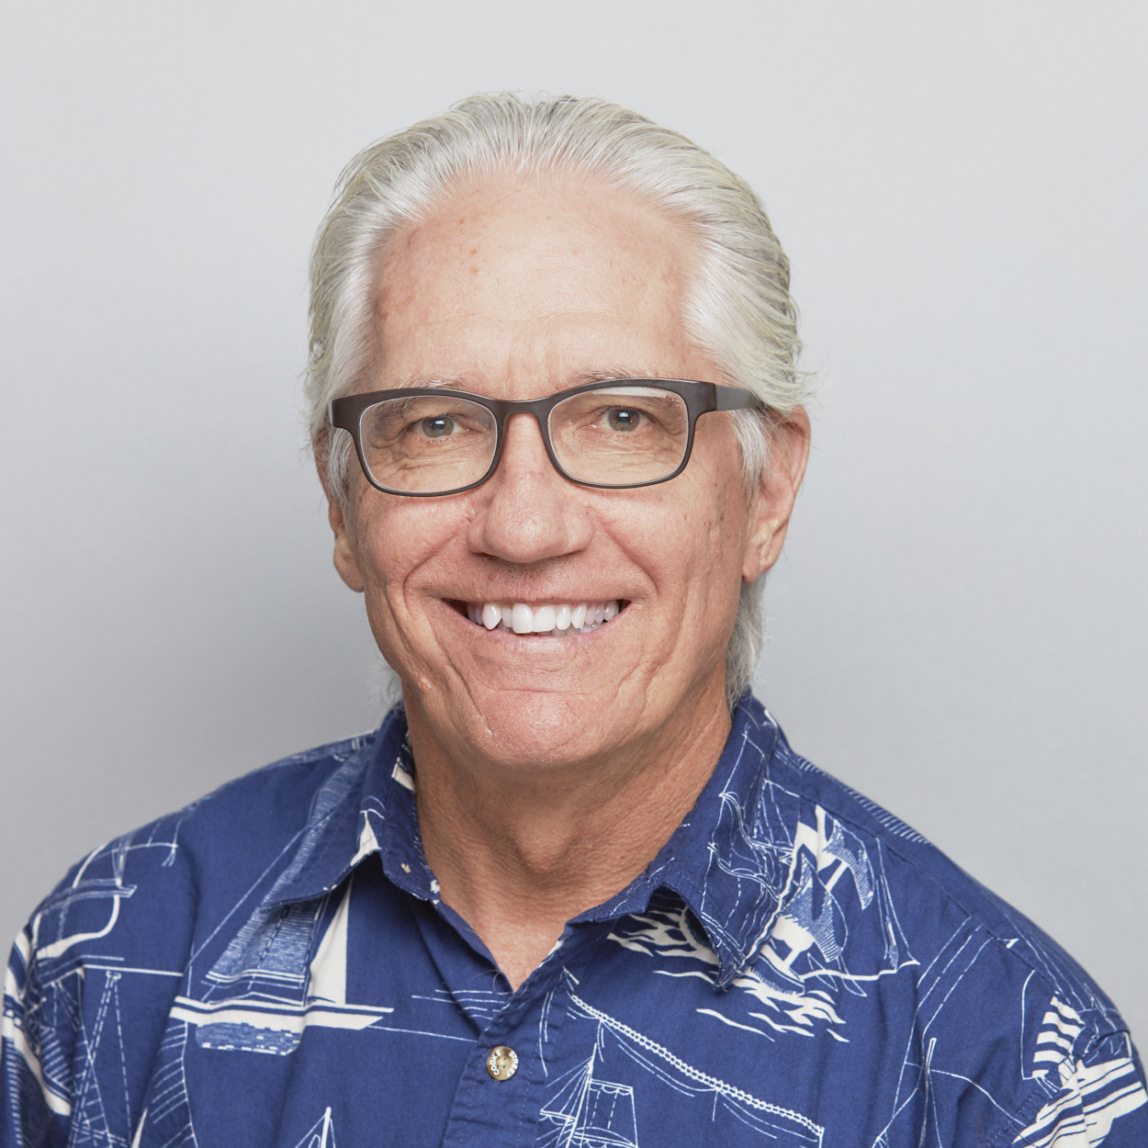
Dr. Joe Hellerman Quote

Slide 13
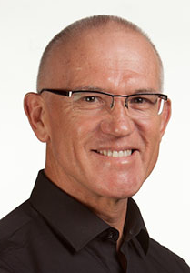
Dr. Mark Keown Quote

Slide 14
Dr. Ralph P. Martin Quote

Slide 15
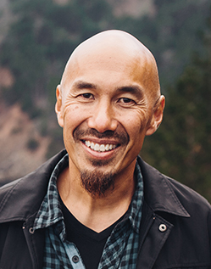
Dr. Tony Merida & Frances Chan Quote

Slide 16
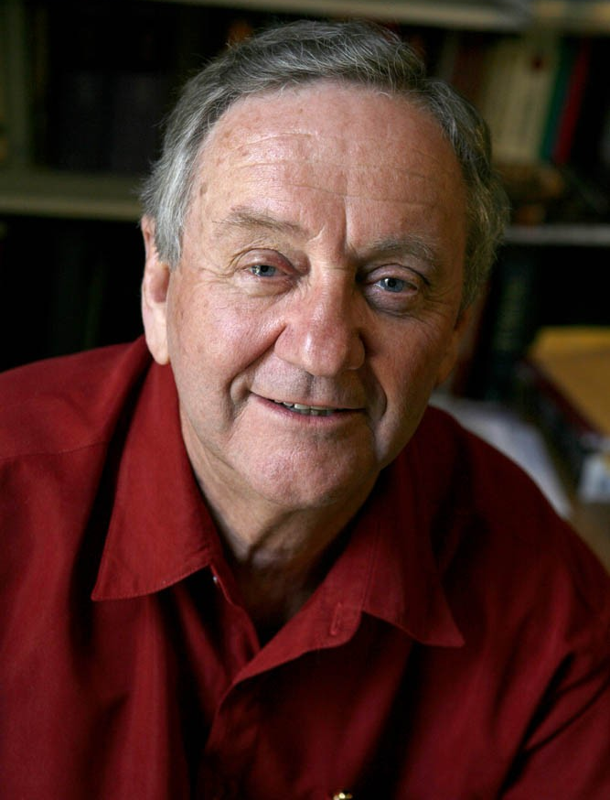
Dr. Peter T. O’Brien Quote

Slide 17
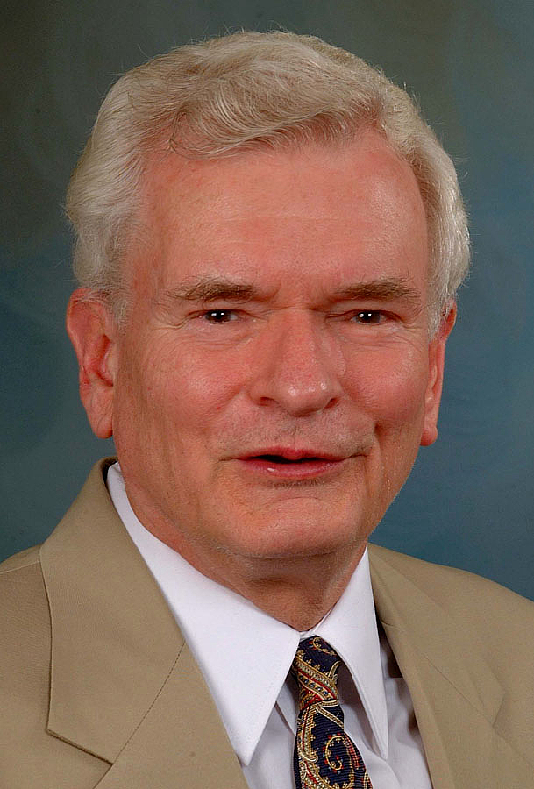
Dr. John Reumann Quote

Slide 18
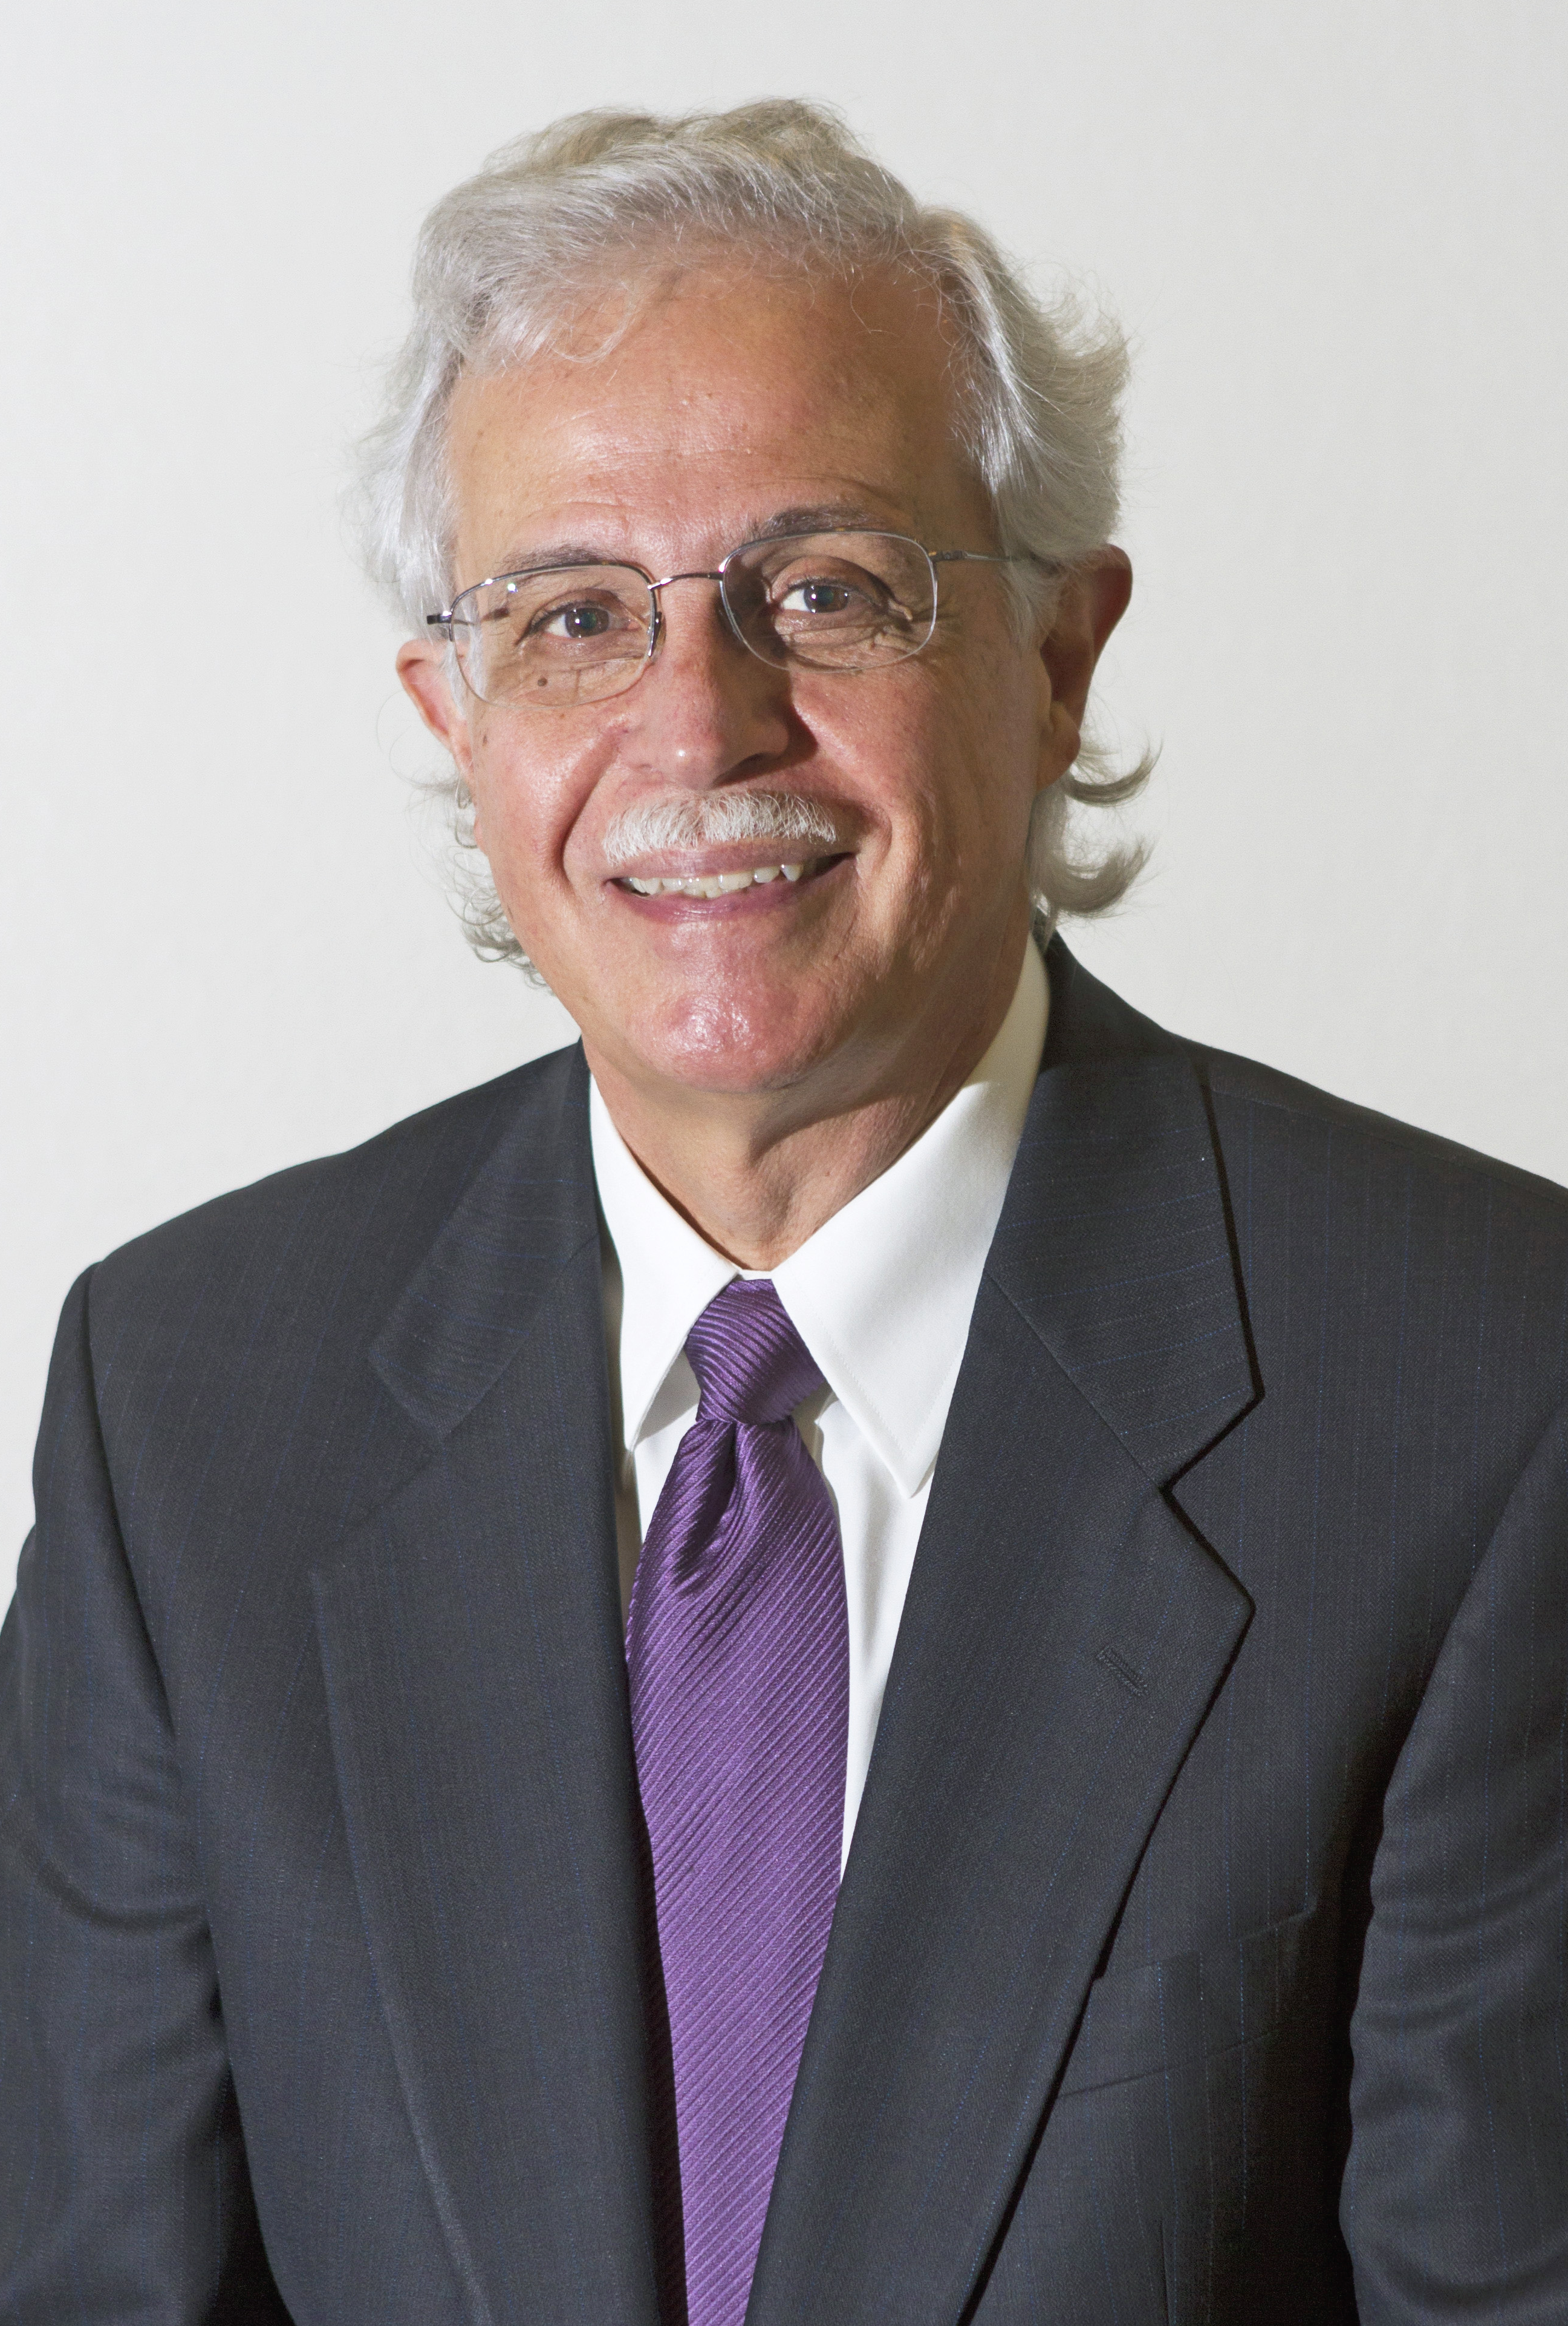
Dr. Moises Silva Quote

Slide 19
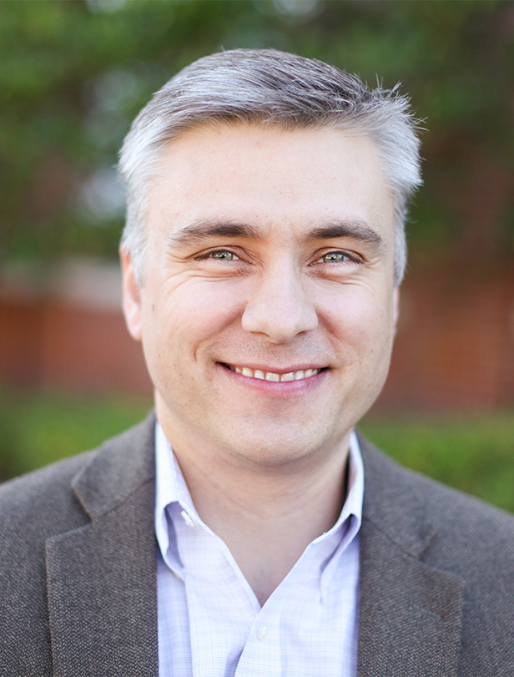
Dr. David T. A. Strain Quote

Slide 20
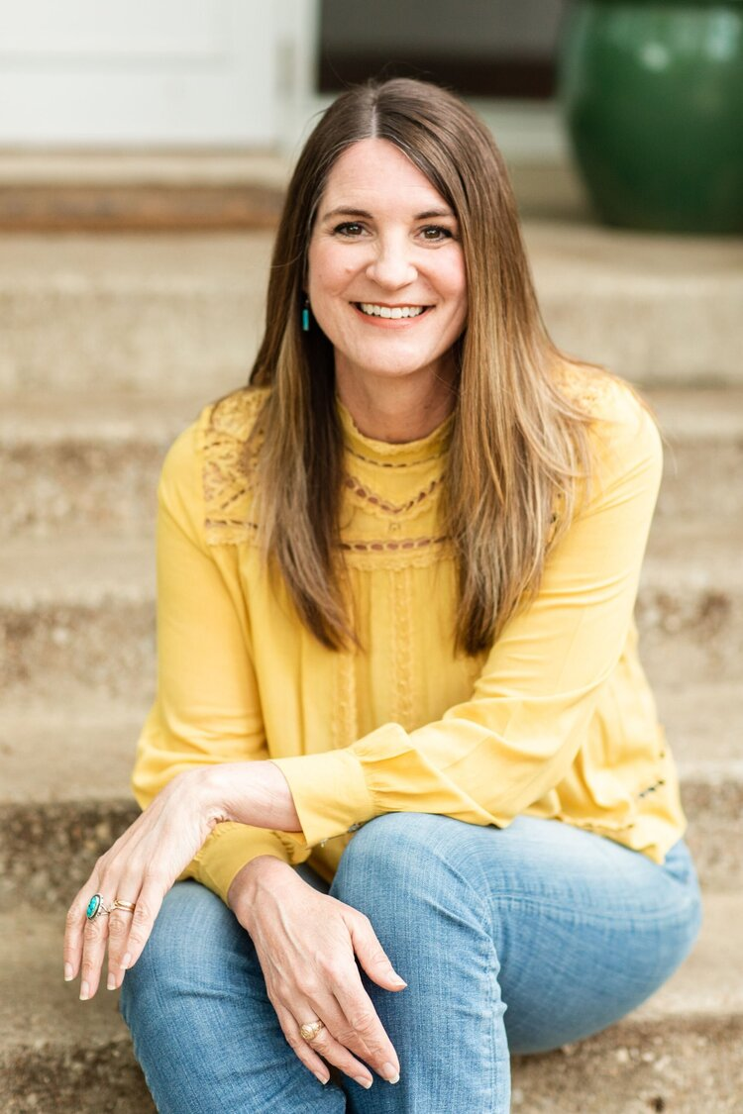
Jen Wilkin Quote

